Slide 1

DEPARTMENT OF COMPUTER SCIENCE Project Presentation (KCS 851) AUTOMATED ATTENDANCE PORTAL (USING RFID AND FACE RECOGNITION)
Guide Name:-Prof.Anmol Jain(Assistant Professor)
1.Anand Parashar(2000290120023, CS 8A)
2.Antriksh Tyagi(2100290129004,CS 8A)
3. Devraj Gupta(2000290120062,CS 8A)
4.Ansh Srivastava(2000290120028,CS 8A)

Slide 2
Problem Statement
In higher education and organizational settings, traditional attendance management methods are manual, time-consuming, error-prone, and vulnerable to manipulation.
These methods typically rely on paper-based attendance sheets or electronic systems like RFID cards, which may suffer from issues such as buddy punching or loss of cards.
There is a need for an automated attendance management system that leverages advanced technologies to overcome these limitations and streamline the attendance tracking process.

Slide 3
Objectives
Develop a face recognition algorithm capable of accurately identifying individuals from facial images captured by a camera.
Integrate the face recognition system with a PHP-based backend to enable real-time data exchange and processing.
Automate the attendance tracking process to eliminate manual data entry and reduce administrative workload.
Provide a user-friendly web interface for administrators, educators, and students to view attendance records, generate reports, and perform other administrative tasks.

Slide 4
Technology Used
Python
Open CV
Hypertext Preprocessor(PHP)
My SQL
PYTHON
Python is powerful and fast, plays well with others, runs everywhere is friendly and easy to learn. Python source files use the " .py " extension and are called "modules.“
There are variety of Functions ,Variables and libraries used in this project to provide efficient working of algorithm.

Slide 5
Technology Used(cont..)
Open CV
OpenCV (Open-Source Computer Vision Library) is an open-source computer vision and machine learning software library.
It provides a wide range of functionalities for image and video processing, including object detection, face recognition, feature detection, image filtering, and more.
Support of Graphical User Interface(GUI) tools.
is widely used in research, academia, and industry for a wide range of computer vision tasks and applications.

Slide 6
Technology Used(cont..)
Hypertext Preprocessor(PHP)
PHP is a versatile and widely used programming language for web development, known for its simplicity, flexibility, and broad ecosystem of tools and resources.
PHP is utilized to handle the core backend logic of the system, including processing RFID inputs and integrating with facial recognition data to manage attendance records.
PHP scripts facilitate seamless interaction with the MySQL database, including querying for class and student information, storing attendance records, and retrieving data for reports and analysis.

Slide 7
Technology Used(cont..)
MY SQL
MySQL is an open-source relational database management system (RDBMS) that is widely used for building scalable, high-performance web applications.
MySQL is known for its reliability, ease of use, and comprehensive feature set.
widely used in web development, e-commerce, content management, social networking, and other applications.
A popular choice for building and managing databases in various industries and domains.

Slide 8
Literature Survey-1
Paper Title: Real-Time Smart Attendance System using Face recognition Techniques.
Author Name: shreyak Sahwney, Karan Kracker, Samyak Jain, Rakesh Garg.
Journal Name: 2019 IEEE
Year of Publishing: 2019
Summary:
This paper proposes a real-time smart attendance system using face recognition techniques, focusing on the use of Eigenface values, Principal Component Analysis (PCA), and Convolutional Neural Network (CNN). The system aims to improve the management of student attendance by reducing the workload on teachers. The attendance management system can be implemented using human face recognition (HFR), which involves capturing students' facial images during their entrance or when everyone is seated in the classroom. Two methodologies are used for HFR: feature-based and brightness-based. The feature-based methodology uses key point features on the face, such as eyes, nose, mouth, or edges, while the brightness-based methodology consolidates and computes all parts of the given picture.
The face recognition process involves face detection and recognition. The images of students' faces are captured from a camera installed in the classroom, and the image is upgraded using image processing methods like grayscale conversion and histogram equalization. The image is then passed to face detection, followed by face recognition using strategies like Eigen face, PCA, and LDA hybrid algorithm.

Slide 9
Literature Survey-2
Paper Title: Face Recognition Based Lecture Attendance System
Author Name: Yohei KAWAGUCHI,Tetsno Shoji,Wejjane LIN,Koh KAKUSHO.
Journal Name: Science journal of informatics Kyoto
Year of Publishing:2018
Summary:
This paper proposes a lecture attendance system based on face recognition technology. The system automatically takes attendance of students for classroom lectures, but face detection rates are not sufficiently high. The authors propose a method for estimating attendance using all results of face recognition obtained by continuous observation. Continuous observation improves the performance for attendance estimation. The lecture attendance system is constructed based on face recognition and applied to classroom lectures. The paper reviews related works in attendance management and face recognition, introduces the system structure and plan, and implements experiments to support the plan. The system uses face image processing technology to estimate attendance, positions, and images of students, which are useful information in classroom lectures. The authors argue that by continuously observing face information, the system can solve the low effectiveness of existing face detection technology and improve the accuracy of face recognition.
This paper presents a system using two cameras: a sensing camera on the ceiling to determine student seating and a capturing camera in front of the seats to capture student faces. The system uses the Active Student Detecting method (ASD) to estimate the existence of a student sitting on the seat using background subtraction and inter-frame subtraction. The camera is directed to the selected seat using registered pan/tilt/zoom

Slide 10
Literature Survey-3
Paper Title: Class Attendance Management System
Author Name: Rashidah Funke ,Wasiu Abedayo,Omar Abdul
Journal Name: 7th intenational conference of ICCCE
Year of Publishing: 2018
Summary:
This paper presents a comprehensive embedded class attendance system using facial recognition and controlling door access. The system is based on a Raspberry Pi running Raspbian (Linux) Operating System installed on a micro-SD card. The Raspberry Pi Camera and a 5-inch screen are connected to the Raspberry Pi, which is programmed to handle face recognition by implementing the Local Binary Patterns algorithm (LBPs). If the student's input image matches the trained dataset image, the prototype door will open using a Servo Motor.
The attendance results are stored in a MySQL database connected to the Attendance Management System (AMS) web server, making the attendance results reachable to any online connected web browser. The system has 95% accuracy with a dataset of 11 person images. The paper discusses two types of face recognition: Two-Dimensional face recognition, which has challenges such as illumination variations, pose facial expression, great occlusion, and image resolution, and Three-Dimensional face recognition, which is not directly deployable due to the difficulty and cost of deploying 3D acquisition devices.

Slide 11
Literature Survey-4
Paper Title: Student Attendance Using Face Recognition Technology
Author Name: Jack Fevrian,Frans Richard,Herry Sofyan,Robert Marco
Journal Name: 7th intenational conference of ICCCE
Year of Publishing:· 2018
Summary:
The paper presents a student attendance system using face recognition, a popular imaging processing application, and a significant role in the technical field. The system aims to digitizate traditional methods of taking attendance by calling names and maintaining paper records.
The paper proposes a system using Haar classifiers, KNN, CNN, SVM, General Adversarial networks, and Gabor filters to tackle the problems of traditional attendance and biometric systems. The system generates attendance reports and stores them in Excel for the student. The system is tested under various conditions, including illumination, head movements, and distance between the student and the camera. After rigorous testing, the system is proven to be an efficient and robust method for taking attendance in a classroom with minimal distraction and manual work.
Attendance is a crucial aspect of education, but traditional methods like roll calls and biometric fingerprinting can be time-consuming and inaccurate. To improve attendance, biometric methods like face recognition have been proposed. Face recognition has proven to be a productive method for taking attendance, but traditional techniques struggle with scaling, pose, illumination, variations, rotation, and occlusions.

Slide 12
Literature Survey-5
Paper Title: Student Attendance System in Classroom Using Face Recognition
Author Name: Samuel Lucas,Aditya Rama Mitra,Ririn Ikana Desanti,Dion
Journal Name:2016 IEEE
Year of Publishing:2016
Summary:
This paper proposes a method for student attendance systems in classrooms using human face recognition (HFR) technique. The system combines Discrete Wavelet Transforms (DWT) and Discrete Cosine Transform (DCT) to extract features of a student's face, followed by applying Radial Basis Function (RBF) for classifying facial objects. The experiments conducted with 16 students in a classroom setting resulted in 121 out of 148 successful faces recognition.
HFR is a widely used technique in biometric verification, used in various applications such as video monitoring, human-computer interaction, door access control systems, and network security. The paper discusses the two known approaches to HFR: feature-based and brightness-based. The feature-based approach uses key point features of the face, while the brightness-based approach calculates all parts of the image. The paper covers the combination of DWT and DCT in HFR and references the key results obtained from preliminary research. The proposed system aims to improve student attendance records in traditional face-to-face classrooms.

Slide 13
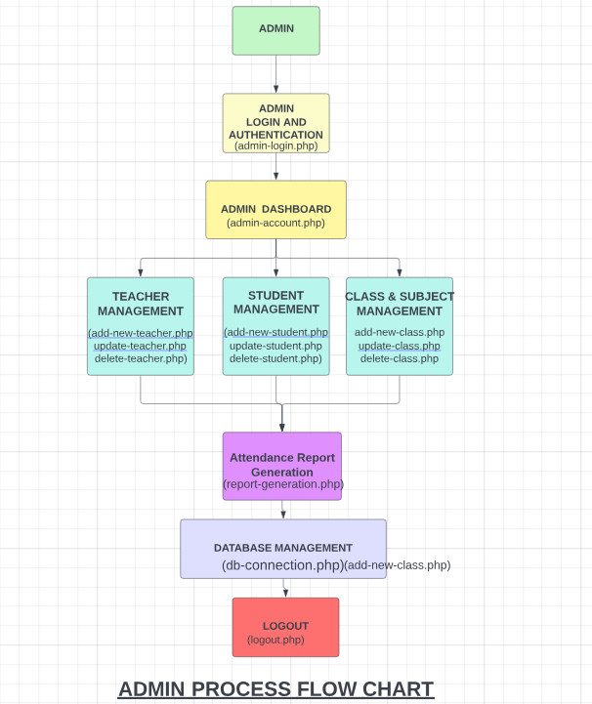
Process Flow Diagram (Admin Level)

Slide 14
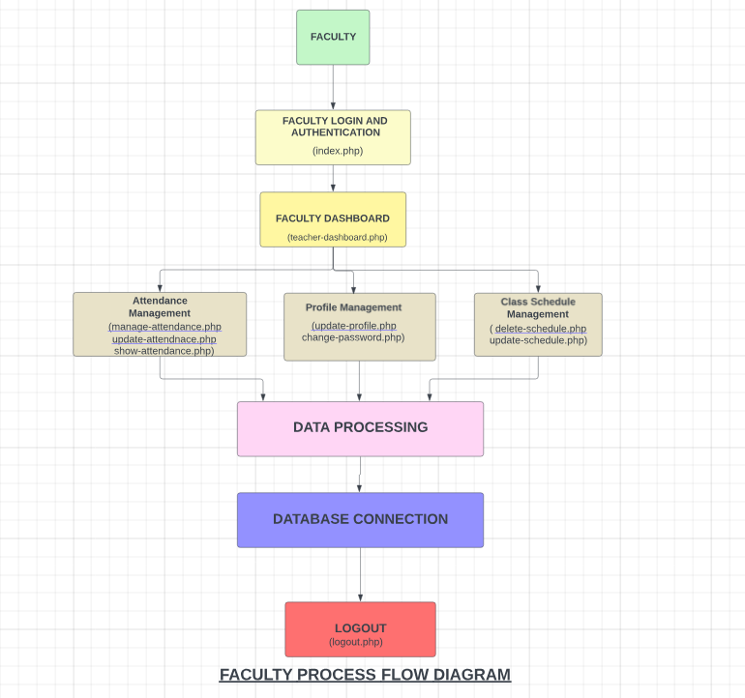
Process Flow Diagram(Faculty-Level)

Slide 15
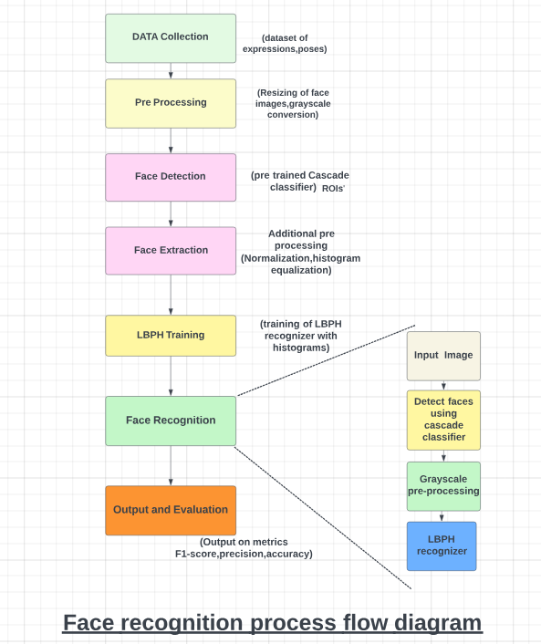
Process Flow Diagram(Facial Recognition)

Slide 16
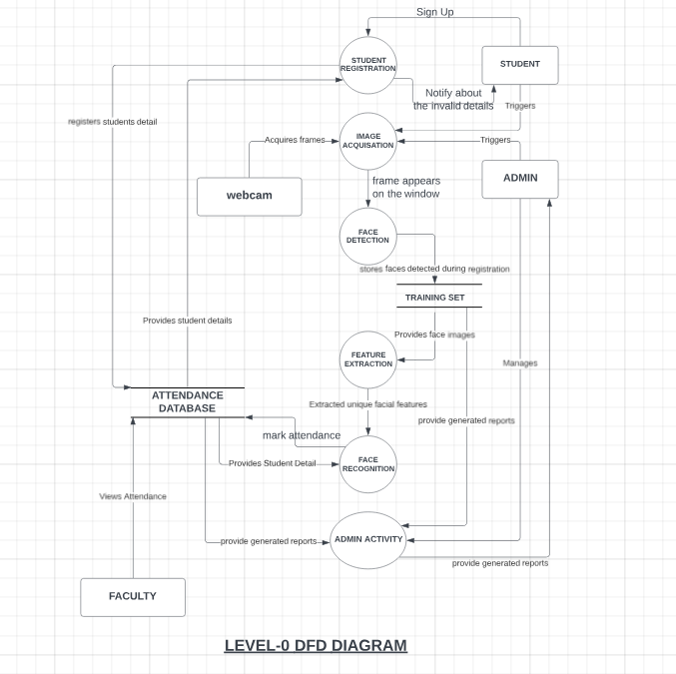
Data-Flow Diagram(LEVEL-0)

Slide 17
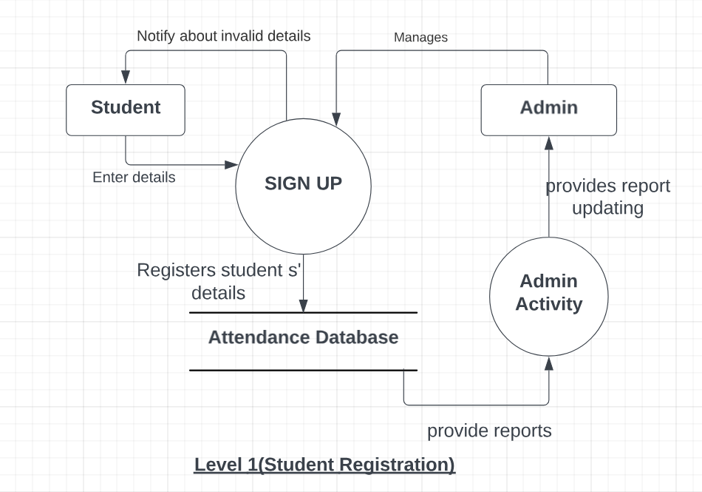
Data-Flow Diagram(LEVEL-1)

Slide 18
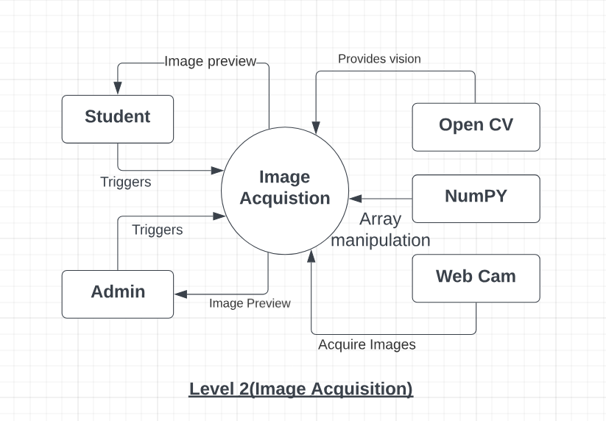
Data-Flow Diagram(LEVEL-2)

Slide 19
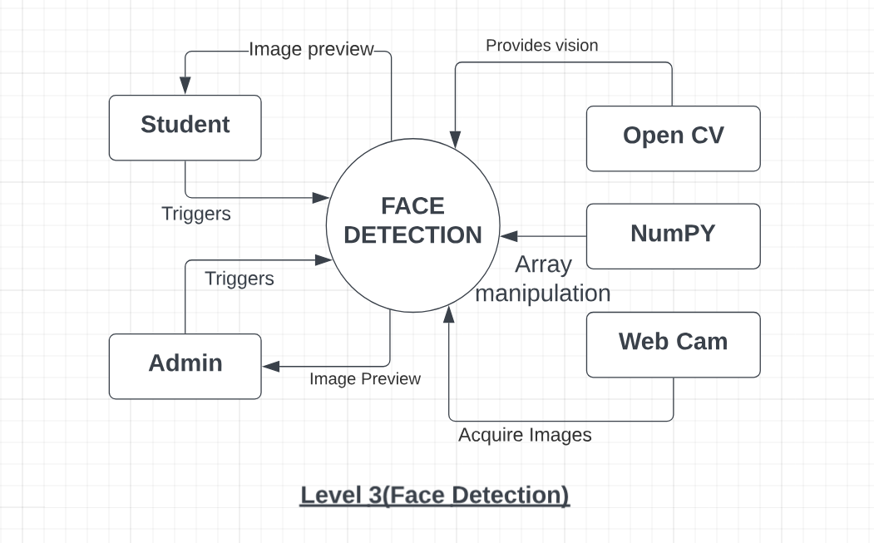
Data-Flow Diagram(LEVEL-3)

Slide 20
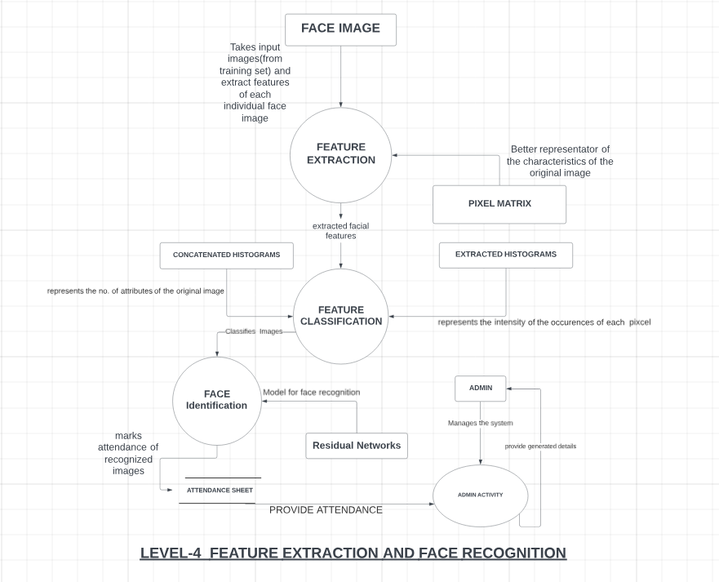
Data-Flow Diagram(LEVEL-4)

Slide 21
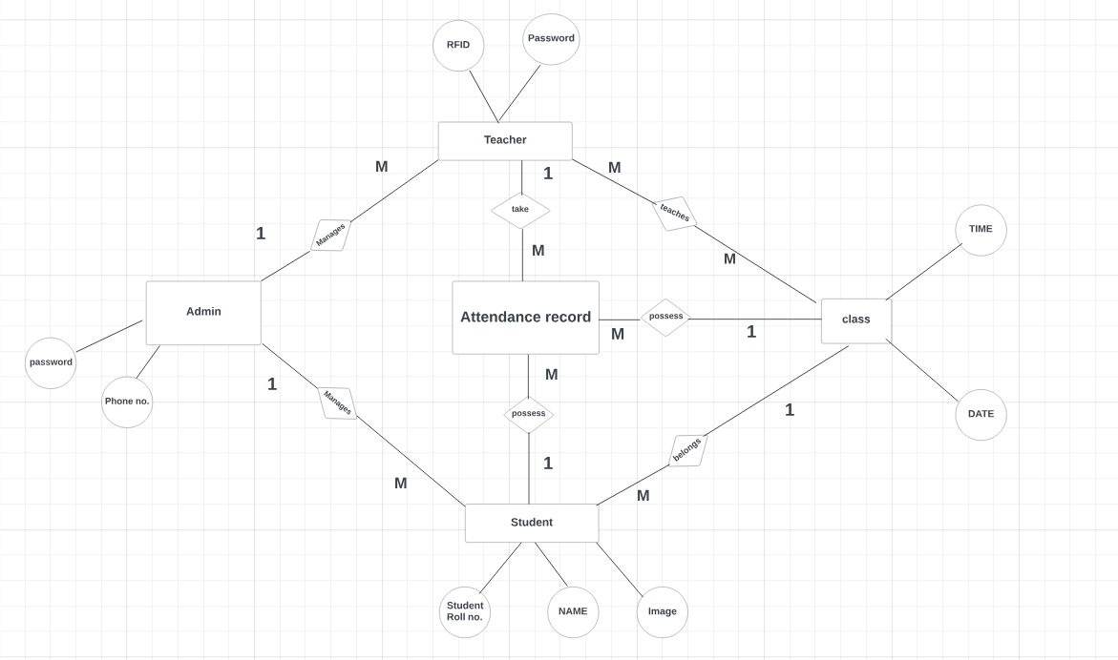
ER-Diagram

Slide 22
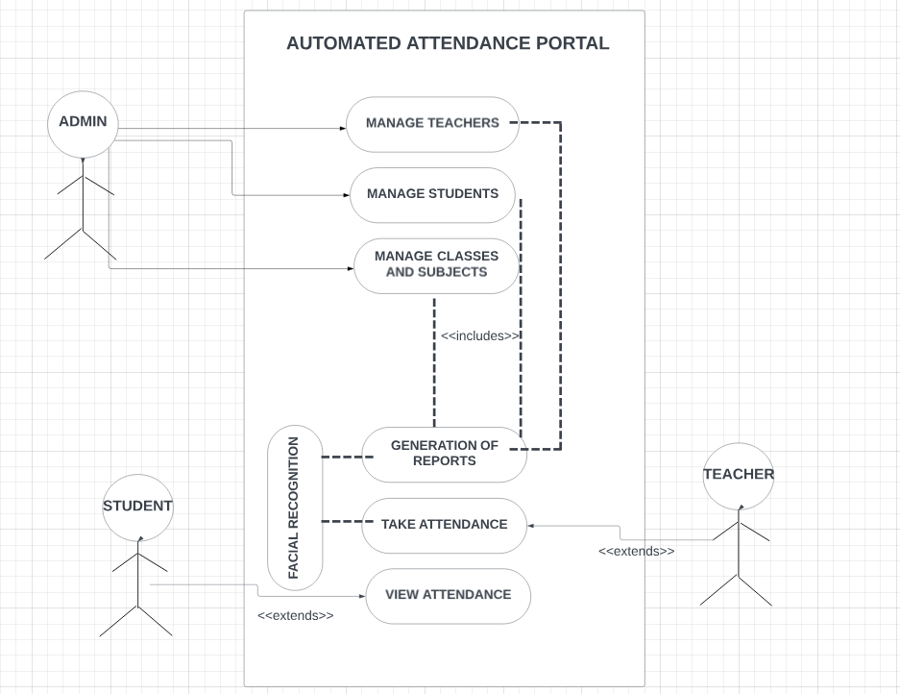
USE-CASE Diagram

Slide 23

Patent Status
Soft copy of patent draft completed 100%
Submitted to guide for Approval.

Slide 24
Research Paper Status
Soft copy of research paper completed 100% .
Draft completion status(100%)
Submission proof (100%)

Slide 25
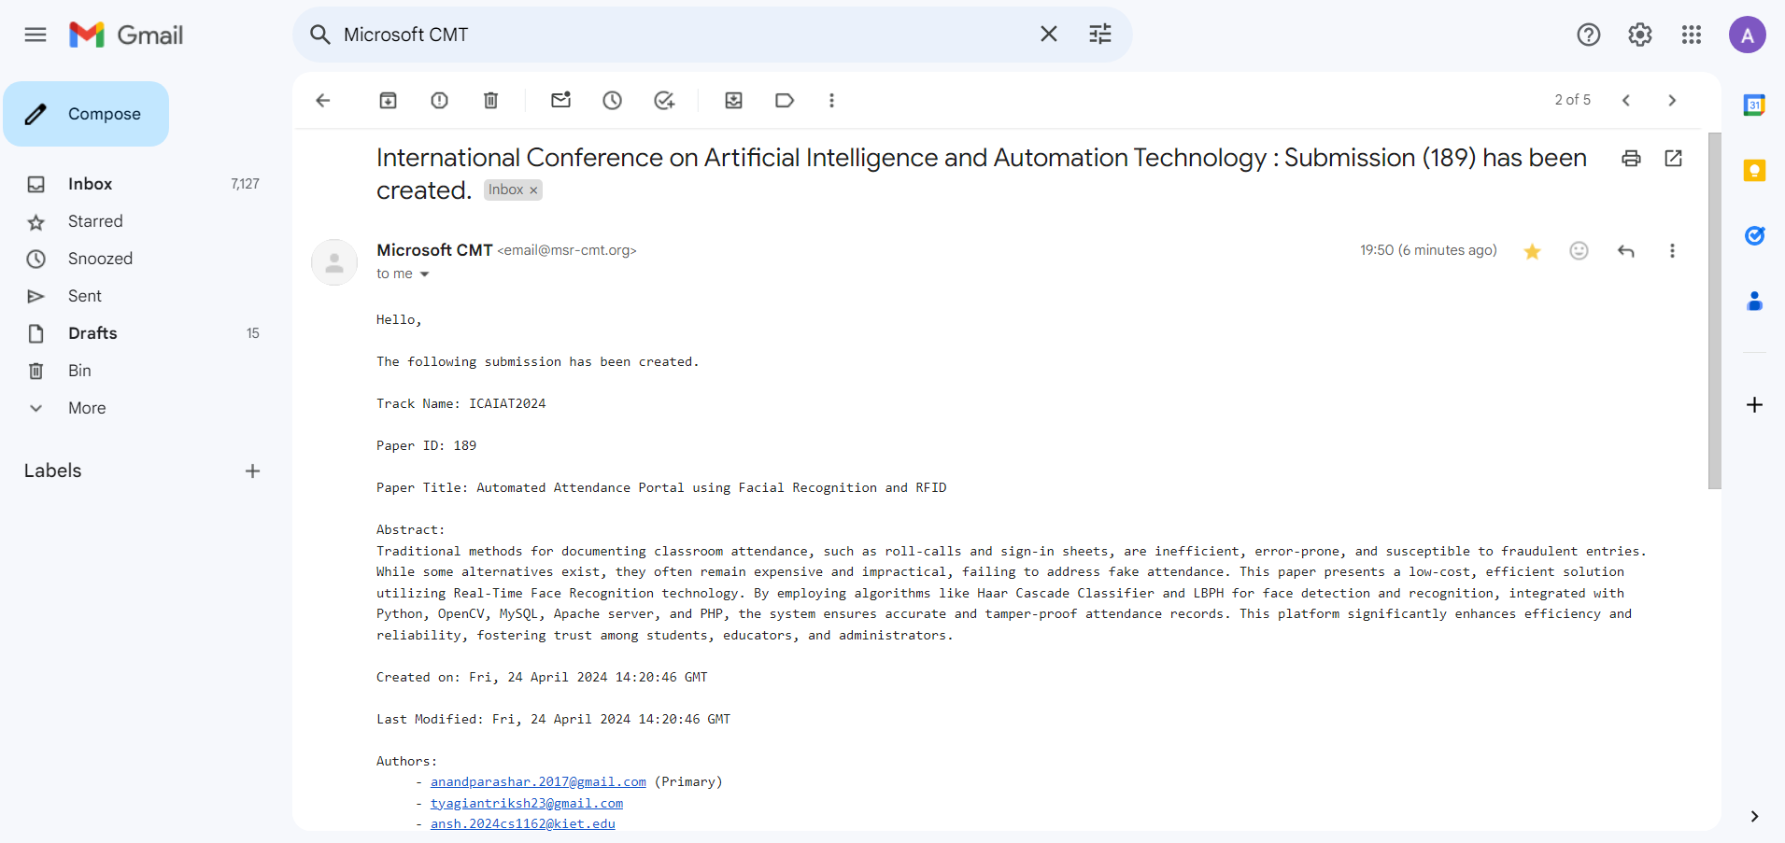
Research Paper submission proof

Slide 26
Project Status
Project is completely Working and is able to perform all sort of critical functionalities.
We are aiming to add more modules that can add to styling through bootstrap and be able to give more GUI features to website.
Addition of more modules to make user friendly website.
Aims to deploy it soon.

Slide 27
References
1. Heusch, G., Rodriguez, Y., Marcel, S.: Local Binary Patterns as an Image Preprocessing for Face Authentication. In: Proc FGR 2006, pp. 9–14 (2006)
2. Zhang, G., Huang, Z., Li, S.Z.: Boosting local binary pattern (LBP)-based face recognition. In: SinoBiometrics 2004, pp. 179–186 (2004)
3. Beveridge, J.R., Bolme, D., Teixeira, M., Draper, B.: The CSU Face Identification Evaluation System User’s Guide: Version 5.0, Technical Report, C.S. Dept., CSU (2003)
4. Messer, K., Matas, J., Kittler, J., Jonsson, K.: XM2VTSDB: The extended M2VTS database. In: Akumuri, S., Kullman, C. (eds.) AVBPA’99, pp. 72–77 (1999)
5. Messor, K., Kittler, J., Short, J., Heusch, G., Cardinaux, F., Marcel, S., Rodriguez, Y., Shan, S., Su, Y., Gao, W., Chen, X.: Performance Characterisation of Face Recognition Algorithms and Their Sensitivity to Severe Illumination Changes. In: ICB2006, pp. 1–11 (2006)
6. Philips, P.J., Moon, H.J., Rizvi, S.A., Rauss, P.J.: The FERET Evaluation Methodology for Face Recognition Algorithms. PAMI 22(10), 1090–1104 (2000)

Slide 28
References(contd…)
7. Belhumeur, P.N., Hespanha, J.P., Kriegman, D.J.: Eigenfaces vs. Fisherfaces: Recognition using Class Specific Linear Projection. In: Buxton, B.F., Cipolla, R. (eds.) ECCV 1996. LNCS, vol. 1065, pp. 45–56. Springer, Heidelberg (1996)
8. Shan, S., Zhang, W., Su, Y., Xhen, X., Gao, W.: Ensemble of Piecewise FDA based on Spatial Histogram of Local (Gabor) Binary Patterns for Face Recognition. In: ICPR (2006)
9. Ahonen, T., Hadid, A., Pietikäinen, M.: Face description with local binary patterns: Application to face recognition. PAMI 28(12), 2037–2041 (2006)
10. Ojala, T., Pietikäinen, M., Mäenpää, T.: Multiresolution Gray-Scale and Rotation Invariant Texture Classification with Local Binary Patterns. PAMI 24(7), 971–987 (2002)
11. Zhang, W., Shan, S., Zhang, H., Gao, W., Chen, X.: Multi-resolution histogram of local variation patterns (MHLVP) for Robust Face Recognition. In: Kanade, T., Jain, A., Ratha, N.K. (eds.) AVBPA 2005. LNCS, vol. 3546, pp. 937–944. Springer, Heidelberg (2005)
12. Huang, X., Li, S.Z., Wang, Y.: Jensen-Shannon Boosting Learning for Object recognition. In: Proceeding of CVPR (2005)
13. Raja, Y., Gong, S.: Sparse Multiscale Local Binary Patterns. In: Proc. 17thBMVC (2006)
14. Rodriguez, Y., Marcel, S.: Face authentication using adapted local binary pattern histogram. In: Leonardis, A., Bischof, H., Pinz, A. (eds.) ECCV 2006. LNCS, vol. 3954, pp. 321–332. Springer, Heidelberg (2006).

